Slide 1

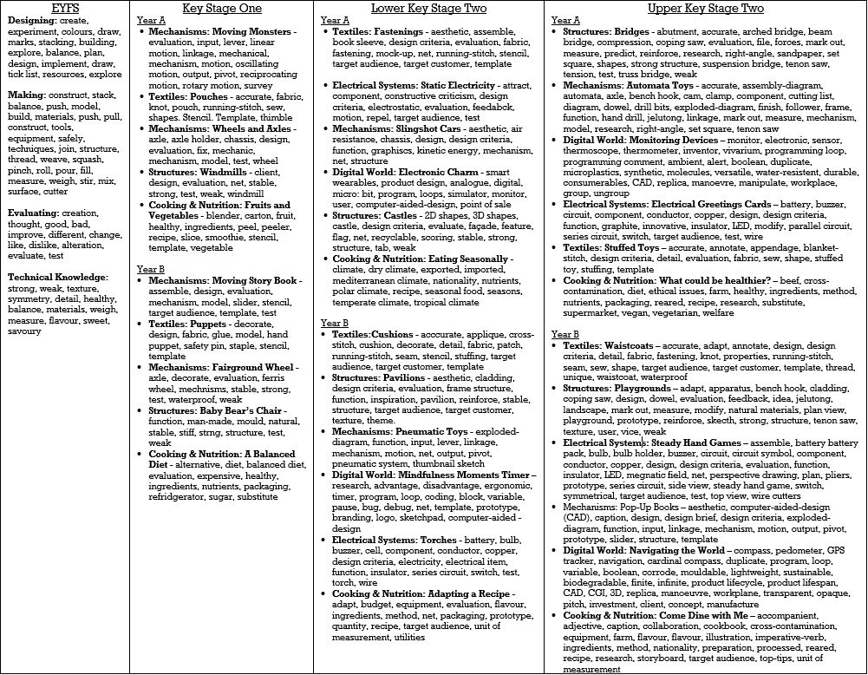
Design and Technology Vocabulary Progression

